Slide 1
Registration
MSU German
+ MSU in general

Slide 2
General Registration Resources
Registrar Office
Montana Hall Main Floor
https://www.montana.edu/registrar/registration.html
Modern Languages Department
Gaines Hall 117
https://www.montana.edu/mll/german/index.html
MSU Academic Advising
Gaines Hall 130
https://www.montana.edu/universitystudies/advising/
Registration PIN – Peter Schweppe (appointment or email)
Gaines Hall 118F
peter.schweppe@montana.edu

Slide 3
How to declare a Minor or Major
(and, how to switch anything)

Slide 4
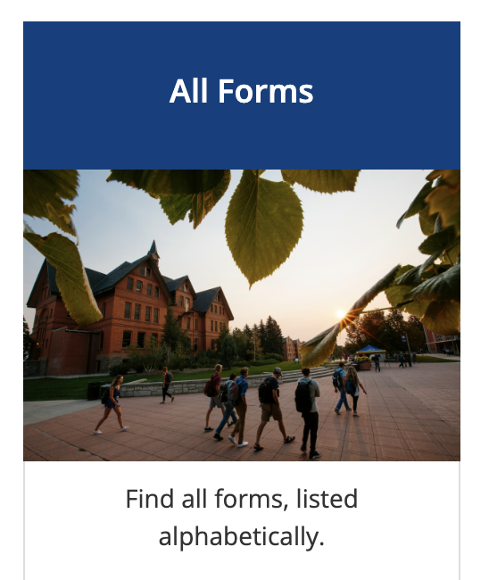
Step 1: Registrar Website
https://www.montana.edu/registrar/
Step 2: “All Forms”
Scroll down to Registrar “All Forms”
https://www.montana.edu/registrar/forms.html
Step 3: “Curriculum & Catalog Change”
Scroll down to “Curriculum & Catalog”
https://www.montana.edu/registrar/curriculum_catalogchange.html
Step 4: Find the Blue Button
Scroll down to this

Slide 5
How to fill out the form

Slide 6
Step 1: Input your information
Step 2: Input your current department advisor (or if none, put in new one twice)
Step 3: Input new department advisor/certifying officer:
Peter Schweppe, peter.schweppe@montana.edu
or: Lisa Roots, lisa.roots@montana.edu
Step 4: After you hit enter, you will go to a DocuSign PDF page
“Catalog Year” (the year you started at MSU, upper-right corner of DegreeWorks)
“New Department” (Modern Languages/Literatures, or “MLL”)
“New Concentration” (German Studies, or MLL German Studies)
Note: If the form asks for “Advisor” or “Certifying Officer” just put in new advisor information (Pete, or Lisa might work too)

Slide 7
How to pick classes

Slide 8
Schedule
Think about how you best operate. MWF? T/Th? Mornings? Afternoons? Think also about your comprehensive experience. Do you have a job? Might you get one? What schedule might leave you optimal slots of time to work?
CORE (IH, D, R, etc.) (link)
Think about your CORE credits. Try to do 1-2 of these every semester until they are completed. Be strategic. If you can do two things at once, that saves you time and effort. ie: a GRMN 355IH = upper level German AND a core “IH.” When you search for courses, you can search for specific core options each given semester.
Experience + Training
Do you need to prove your language proficiency for a future professional opportunity? Then, focus on our upper level rotating language courses: GRMN 301, 302, 303, 304. These can be taken in any order; they build language skills. Are you more interested in cultural or literary questions? Take a look at our other upper-level options.

Slide 9
MSU German
on Instagram at @MSU_German
Follow us for humorous or interesting daily stories, announcements, etc.

Slide 10
MSU German curriculum + courses
MSU official site:
https://www.montana.edu/mll/german/index.html
German Studies Major Requirements (hyperlink)
German Studies Minor Requirements (hyperlink)
German Course Catalog (certain course rules, hyperlink)
MSU German, our site:
https://msugerman.weebly.com/
MSU Course Descriptions (updated every semester):
https://msugerman.weebly.com/our-courses.html

Slide 11
Studying
Interning
Living/Learning
ABROAD

Slide 12
link
link
link
Hint: Go abroad! It’s worth it. Schedule a meeting with the OIP team. They will help.
Or set up meeting with Pete, Liana, or Kate. They can discuss internships, research, and experiential learning.

Slide 13
Miscellaneous
frequently asked questions

Slide 14
a) Placement
Question: I took 3 years of high school German. I have forgotten some, but I don’t think I want to take GRMN 101. Can I skip ahead?
Answer: Yes. We usually like to meet with a student to assess the comfort level + goals with German. Then, we place students into a given course. It is ok to try out a course and then switch up or down a level the first 1-2 weeks of a semester. We are all very nice and open to that.
b) Registration
Question: I think I am eligible to take a course, but it says I’m blocked or not eligible. Help?
Answer: Sorry, there are certain registration glitches that don’t have to do with us. We can usually place an override request and get you into any course that fits your level. Just reach out to the instructor and they will handle from there. *Only the instructor of the course can do this. (contacts here)

Slide 15
c) Back-credits (PLA form)
Question: I took 3 years of high school German. I am starting in GRMN 202. Can I get credit for previous courses?
Answer: Yes. Very easy. Just fill out a “PLA” (previous language assessment) form in the MLL main office. Gaines 117. These credits will automatically appear on your transcript at no charge.
d) Independent Study
Question: I have a super intense course schedule and don’t have time for a regular course. Can I do an independent study?
Answer: In some cases yes. Please meet with Pete and discuss your idea. It is not always possible, but in some cases we are able to chart out a plan that includes a description of your study, dates of submission, and the prospective outcomes (ie: term paper, podcast, art project, other).

Slide 16
Letters of Reference
Yes, we write these for you, and we root for you. Please give your instructors at least 2-3 weeks advance notice wherever possible and make sure we received your email request + said yes. If you ask the night before, there is a good chance we are not able to meet that deadline.
In your request, please include the following:
description of the course you took with us and what specific product or memory you have from it
description of the opportunity and how it will impact you moving forward
name of person + address of your opportunity so we can address our letters
link to the organization wherever possible – this helps us write a stronger letter on your behalf

